Slide 1

/TECHNIQUE DE VEILLE
Batta.jpg
Web Scrapping and Sentiment Analysis
Provided by :
Ameny IHKAF
Mehdi SOMRANI
INDEX.HTML

Slide 2
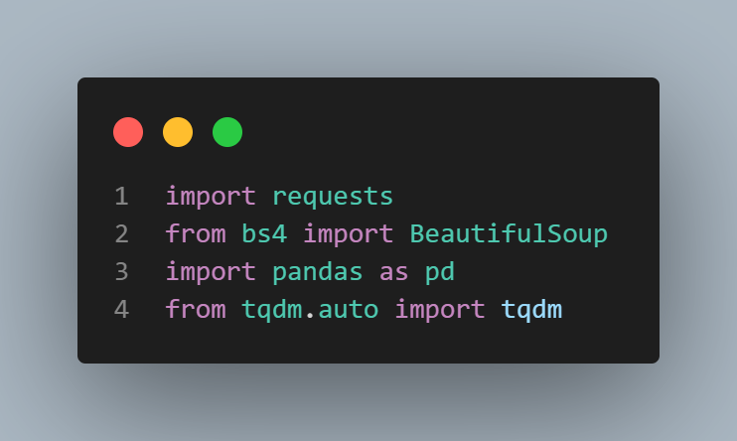
/Scrapping movies
Batta.jpg
Used Libraries
import requests
Used to get HTTP requests
from bs4 import BeautifulSoup
Used to scrap web page
import pandas as pd
Used to manipulate dataframes
from tqdm.auto import tqdm
Used to implement progress bar in loops
PLAN.DATL

Slide 3
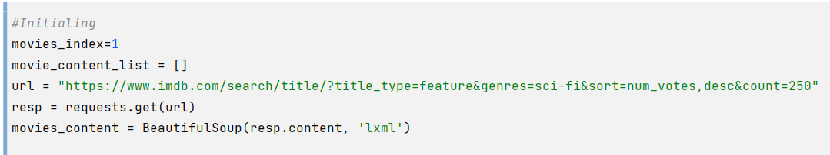
/Scrapping movies
Batta.jpg
Initializing variables to use late such as the url we are going to request data from and converting the request.get response to LXML text type using BeautifulSoup
PLAN.DATL

Slide 4
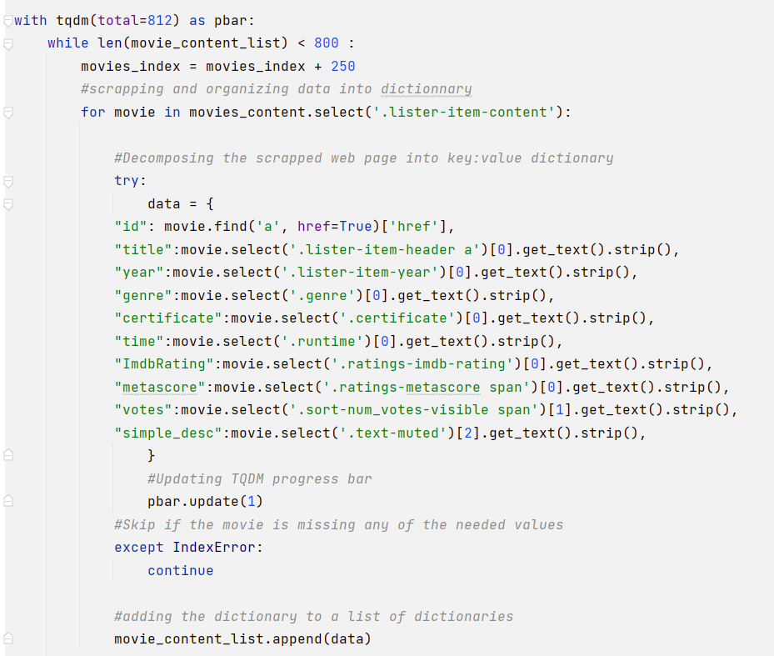
/Scrapping movies
Batta.jpg
Starting the scrapping process with integrating the TQDM library to track the progress in addition to getting needed data while removing unneeded characters and spaces using strip() in a try exception method. Furthermore, we used a Movie_index variable in the url to jump to next page to scrap more movies.
Excluding the movies that misses one or more of the needed values and appending the result to list of dictionaries named movie_content_list
PLAN.DATL

Slide 5
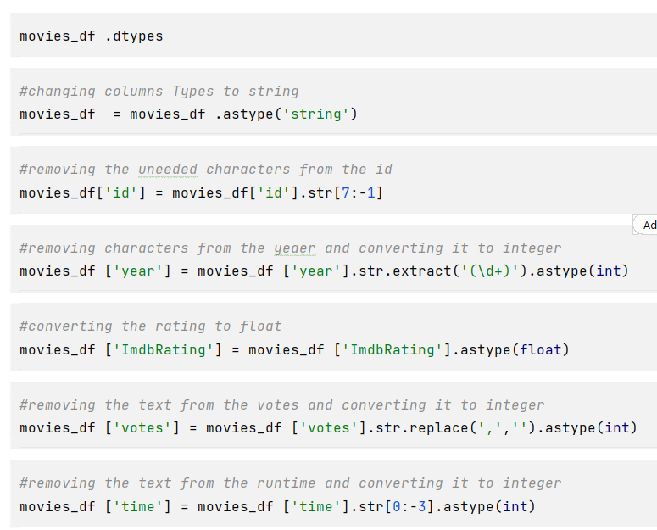
/Cleaning DataFrame
Batta.jpg
Using pandas, we’ve changed the types of the columns and removing the unnecessary characters. We didn’t check for null since we skipped every movie that have any null value
PLAN.DATL

Slide 6
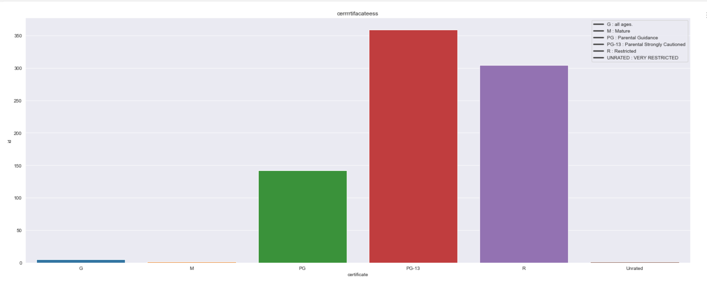
/Data Visualization
Batta.jpg
Using Matplotlib and Seaborn, we visualized the number of sci-movie made in each certificate rate such as PG-13 and R rated movies
As we see most of sci-fi movies are PG-13 rated
PLAN.DATL

Slide 7
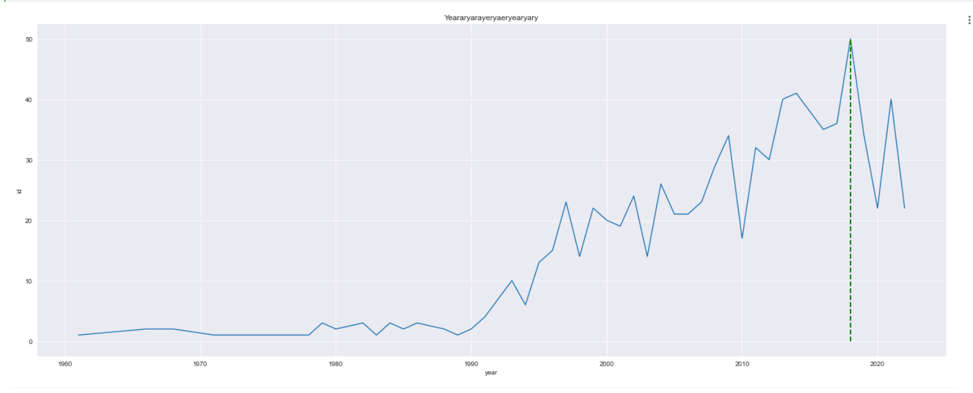
/Data Visualization
Batta.jpg
Using Matplotlib and Seaborn again, We plotted the number of movies made each year with highlighting the peak year, which it was 2019.
2019 was a year full of sci-fi movies
PLAN.DATL

Slide 8
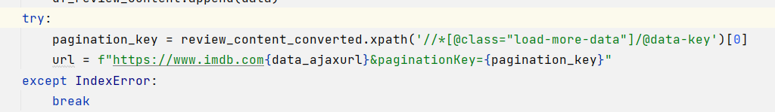
/Scrapping reviews
Batta.jpg
To scrap reviews, we used the same scrapping movie code but instead of changing the url with starting movie rank, we used the ajax-url, which is the id on the button of loadmore.
And the paginationkey, which is the key that takes us to load more data.
We used a while true loop to scrap all the reviews of the movie.
PLAN.DATL

Slide 9
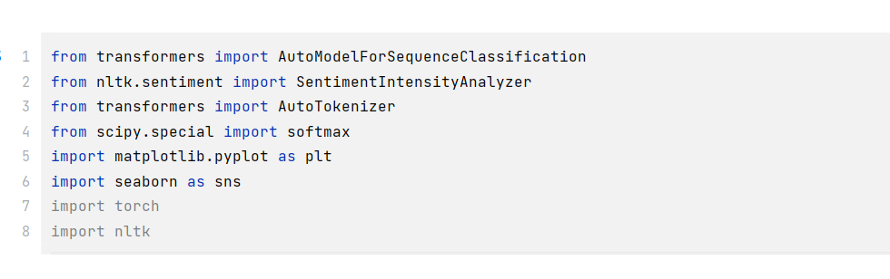
/Sentiment analysis
Batta.jpg
In our sentiment analysis mission, we used the Roberta model to get the positive, negateive and neuteral score of each review. This model requires NLTK,Scipy and Transformers, Pytorch libraries to use SentimentIntensityAnalyser, AutoTokenizer, Softmax and we used pytorch library since softmax depends on it
PLAN.DATL

Slide 10
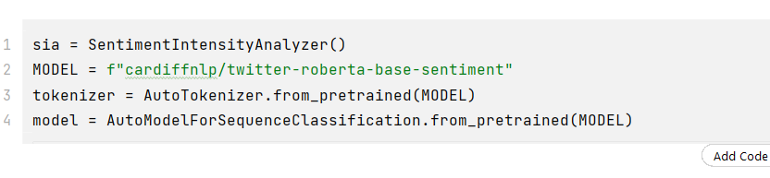
/Sentiment analysis
Batta.jpg
After importing needed libraries, we need to declare our needed variables
We declared the Sentiment analyzer and the model we are going to use, which is Roberta in our case, tokenizer from a pretrained model to scan lexical and the model to get the pretrained version of our model
PLAN.DATL

Slide 11
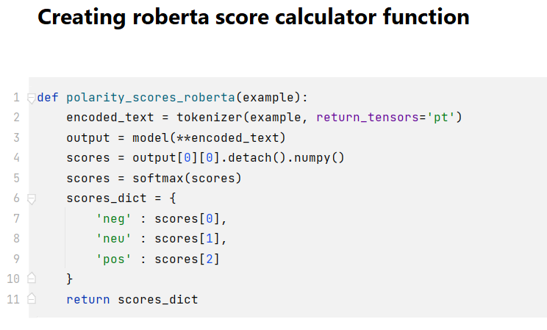
/Sentiment analysis
Batta.jpg
Polarity scores Roberta uses the tokenizer function to scan and encode the text so the model could analyze the sentiments and saving it to output. Then, score detach the output and make it to numpy array, before saving the score to a dictionary we needed to decode the score we found
And finally we return the dictionary
PLAN.DATL

Slide 12
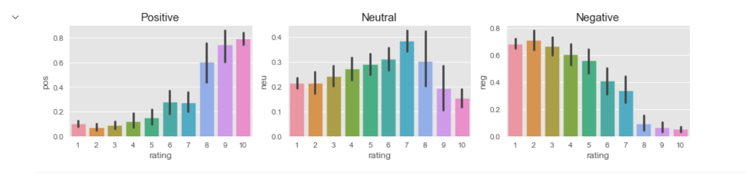
/Sentiment analysis
Batta.jpg
After scrapping the reviews and configuring the model we calculated the sentiment on each row in the reviews dataframe for 5 movies and plotted it using matplotlib and seaborn showing the accuracy between the positive, neutral and negative reviews and their rating of the move
PLAN.DATL

